Slide 1

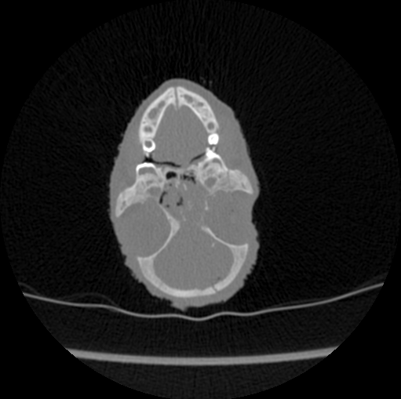
Final Presentation Image Denoising and Restoration based on Residual Deep Learning and Persistent Homology
Students: Chen Ben-Porat, Dana Shpernat
Supervisor: Eli Appleboim
Context: Project A
Semester: Spring, 2020
Date: 16/10/2020

Slide 2
Presentation Outline
Our project’s goal
Background
Optional solutions
Chosen solution
Results
Conclusions

Slide 3
Project Goal
Denoising low-dose CT images in order to make them informative for medical usage and allow accurate diagnosis.
The denoising method need to maintain all the details and edges of the image, and at the same time to be relatively quick and simple.
Notes:
השמשה רפואית, אבחון רפואי מדויק ככל שניתן לצורך כך לשמר פרטים קטנים, קצוות אבל בו זמנית יעיל מהיר ופשוט

Slide 4
CT scans
CT (computed tomography) scan detects internal abnormalities of the body.
The amount of radiation exposure during a scan is very high and can increase risk of diseases.
This radiation can be partially reduced by using low-dose CT scan.
Low-dose scan leads to noisy images.

Slide 5
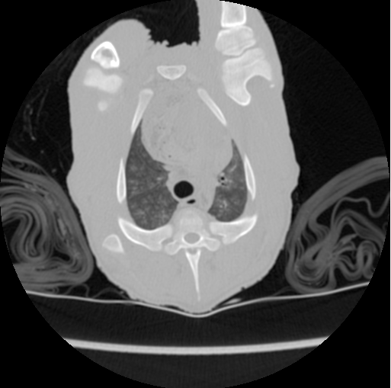

Noisy CT scan - example
normal-dose image
low-dose image

Slide 6
CT scans
Main challenges in CT denoising:
Image boundaries should be preserved (no blurring).
Texture details should not be lost.
Global contrast should be preserved.
New artifacts should not be generated.

Slide 7
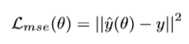
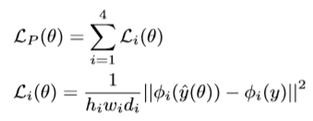
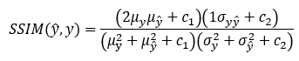
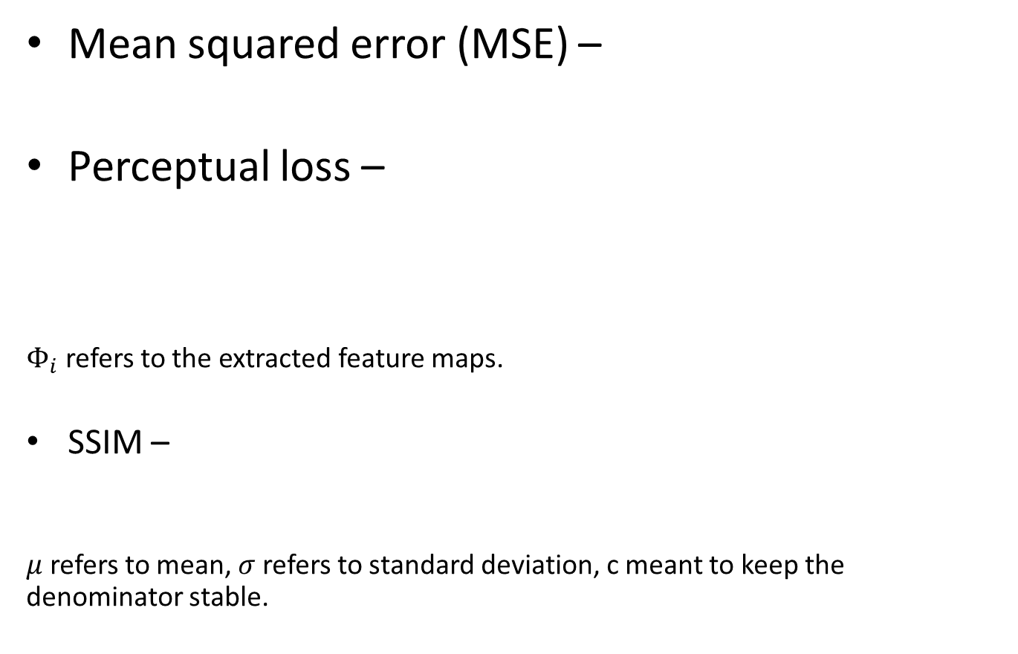
Objective functions
Mean squared error (MSE) –
Perceptual loss –
$Φ_{i}$ refers to the extracted feature maps.
SSIM –
$μ$ refers to mean, $σ$ refers to standard deviation, c meant to keep the denominator stable.

Slide 8
Optional Solutions
Smoothening filters – smooth the noise in the image. Not sufficient and may harm the details in the image.
Sharpening filters – reduce the noise and sharp the edges. Not sufficient.
Convolutional network with different loss functions – reduce the noise. High complexity and long computational time.

Slide 9
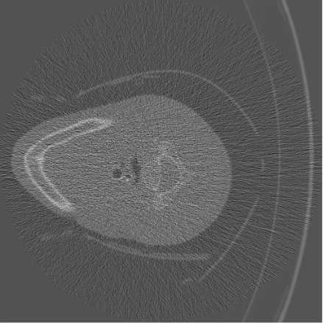
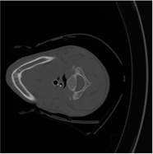
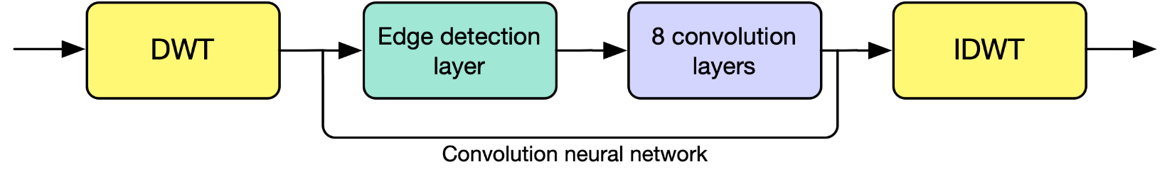
Chosen solution:
Discrete wavelet transform –
provides dimensional reduction and manifold simplification (will be explained).
The transformed image retain the image’s details and edges (critical in CT scans).

Slide 10
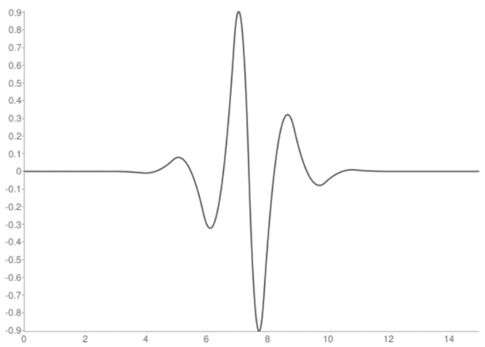
Wavelet transform
A wavelet transform is a linear transformation in which the basis functions are scaled and shifted versions of one function, called the “mother wavelet”.
In this project, the “mother wavelet” that has been chosen is biorthogonal 3.7.

Slide 11
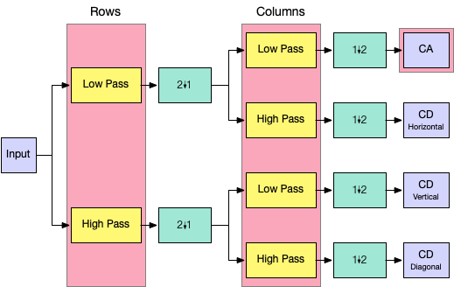
Wavelet transform

Slide 12
Edge detection layer –
a convolutional layer with four Sobel kernels as the non-trainable ﬁlters.
Sobel operator – computes the 2-D gradient of the image intensity in 4 main axes (horizontal, vertical, diagonal).
emphasizes regions with high spatial frequency.
Help maintain little changes in the original image.

Slide 13
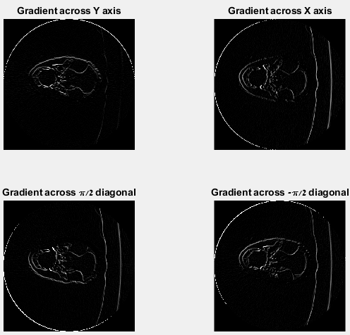
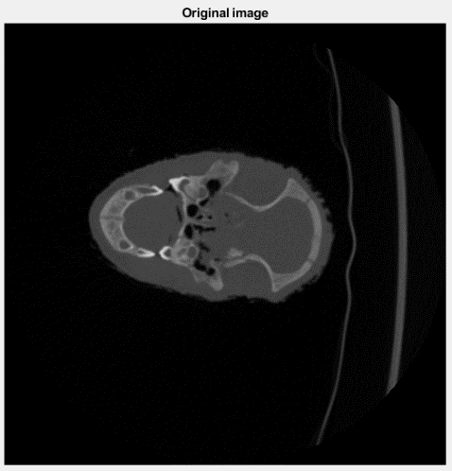
Sobel operator - example

Slide 14
8 convolution layers –
Each layer contain convolution layer, batch normalization layer and ReLU activation function.
Residual connections between layers 6 and 2, 7 and 1, 8 and direct input.
Changing dilation rates.
Different objective functions – MSE, Perceptual error, SSIM.
Notes:
Batch normalization – make artificial neural networks faster and more stable through normalization of the input layer by re-centering and re-scaling

Slide 15
Inverse discrete wavelet transform –
Reconstruct the wanted image from the discrete wavelet coefficients.

Slide 16
Why did we choose this solution?
The wavelet transform allows faster denoising, while retaining the important details.
The suggested network is inspired by an updated article (2019) with proved results.
All the different loss function were proved to be efficient in denoising images in previous studies.

Slide 17
Dataset
904 images from a dataset of piglet’s CT scans.
Each image has two replicas – one is a normal-dose scan (100% radiation), and the other is low dose scan (5% radiation).
The dataset was divided to 80% training and 20% test.

Slide 18
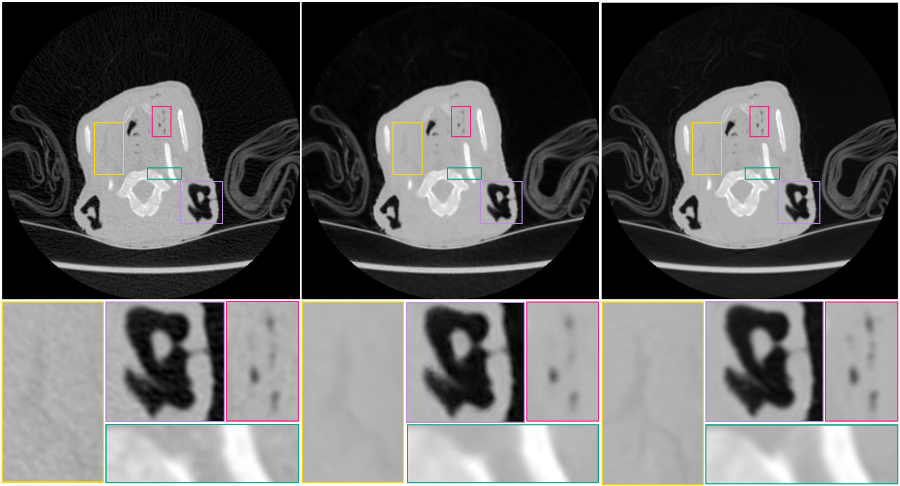
Results– MSE
Noisy image
Result image
Clean image
Notes:
ניתן לראות שהרעש נוקה, אך התוצאה המתקבלת מעט מטושטשת

Slide 19
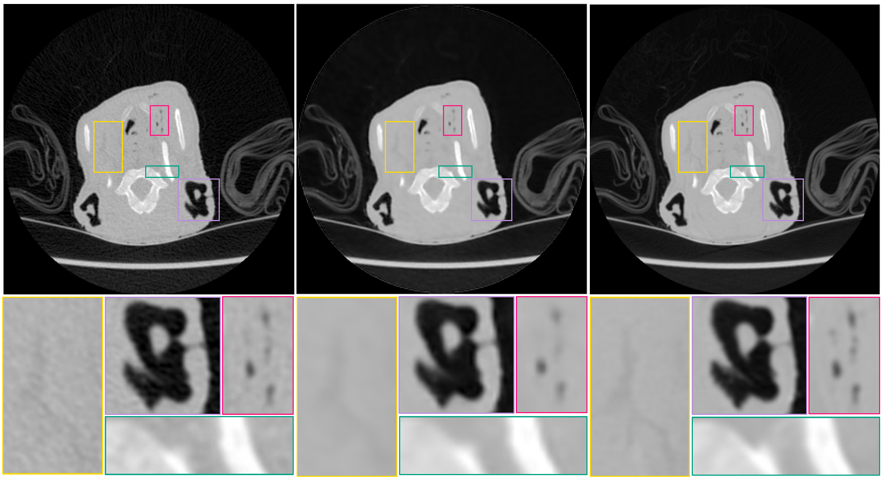
Results – MSE (wavelet)
Noisy image
Result image
Clean image
Notes:
קיבלנו תוצאות דומות, אך מעט פחות טובות, קצר פי 2

Slide 20
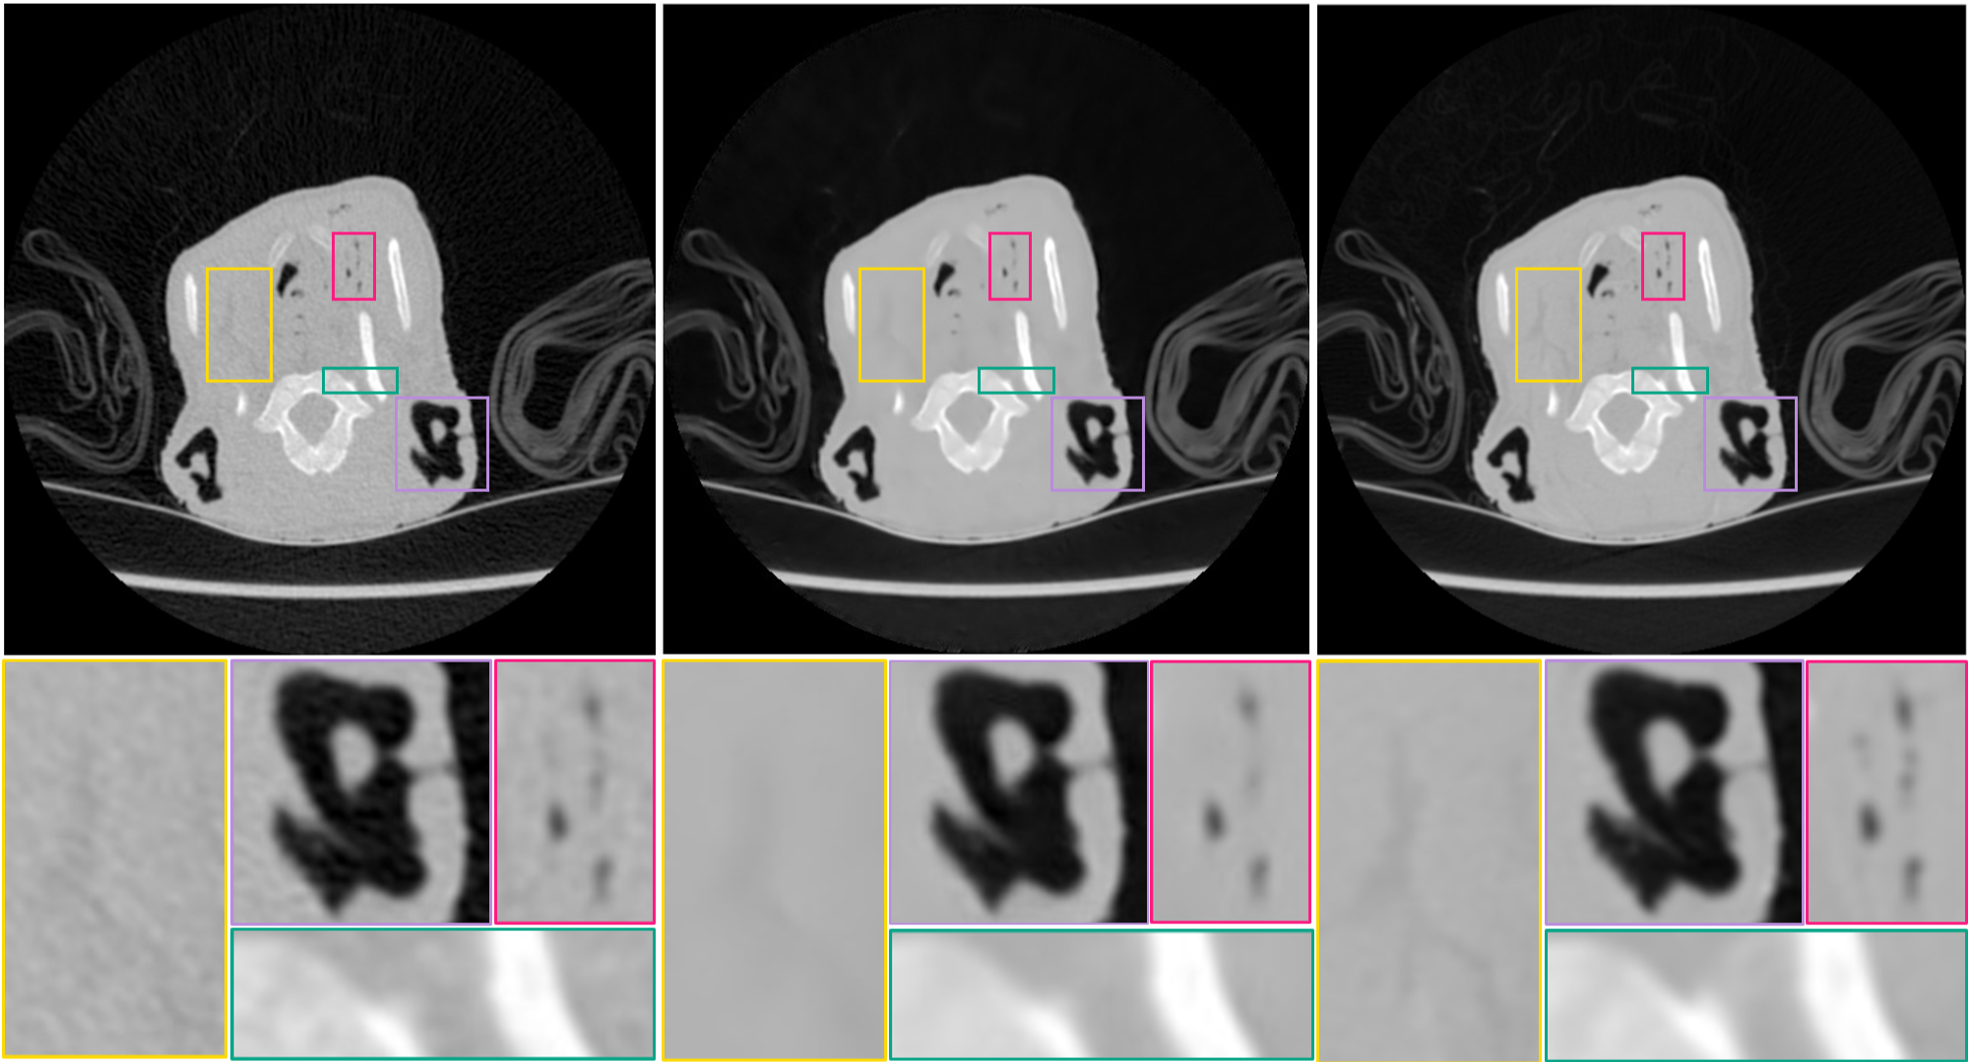
Results – MSE + edge
Noisy image
Result image
Clean image
Notes:
תוצאות מעט יותר מחודדות

Slide 21
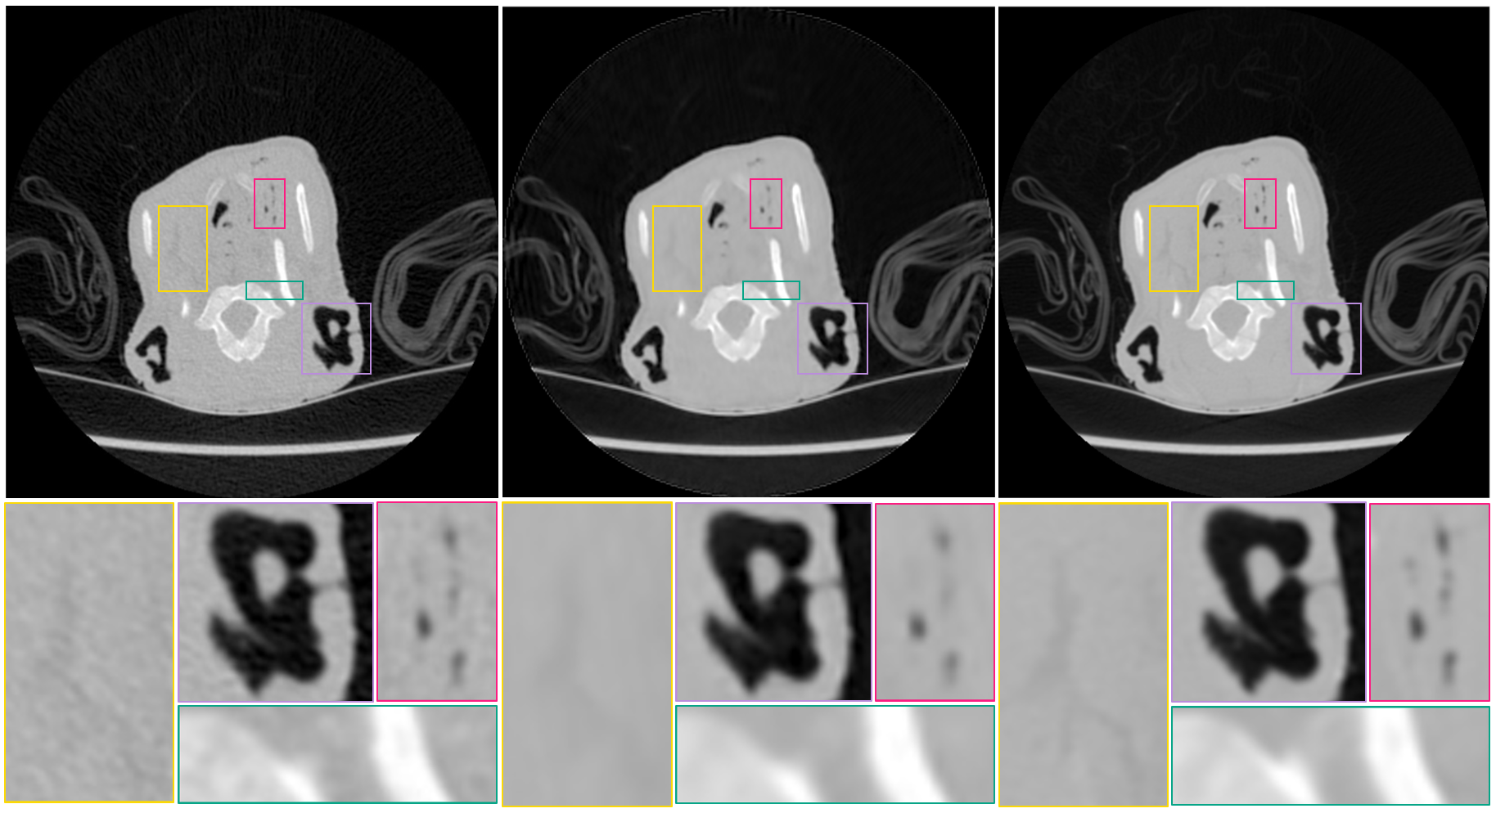
Results – MSE+edge (wavelet)
Noisy image
Result image
Clean image

Slide 22
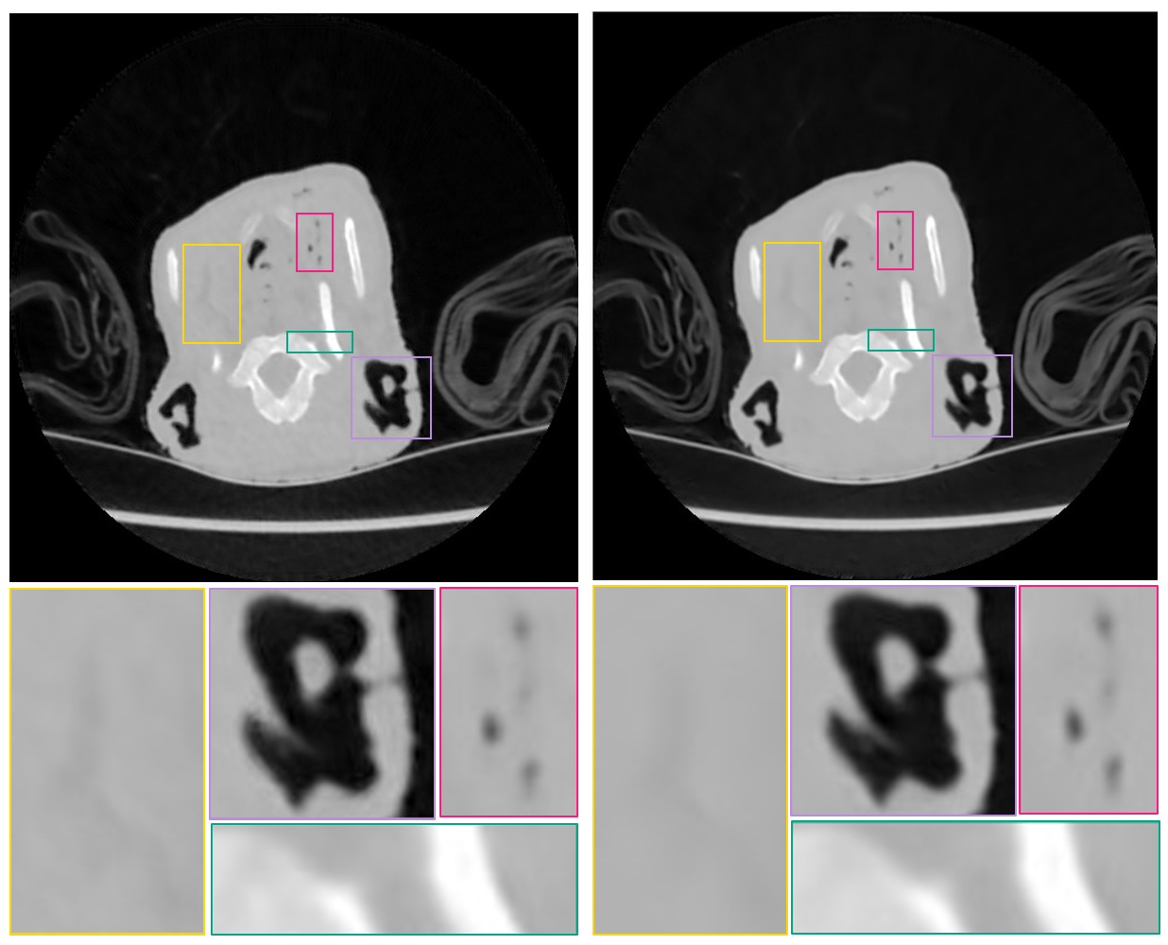
MSE vs. MSE+edge
MSE result
MSE+edge result
Notes:
ניתן לראות ב-edge שהפרטים סה"כ יותר מחודדים (למעט הצלקת) – רואים את זה בצורה ממש ברורה במלבן הורוד

Slide 23
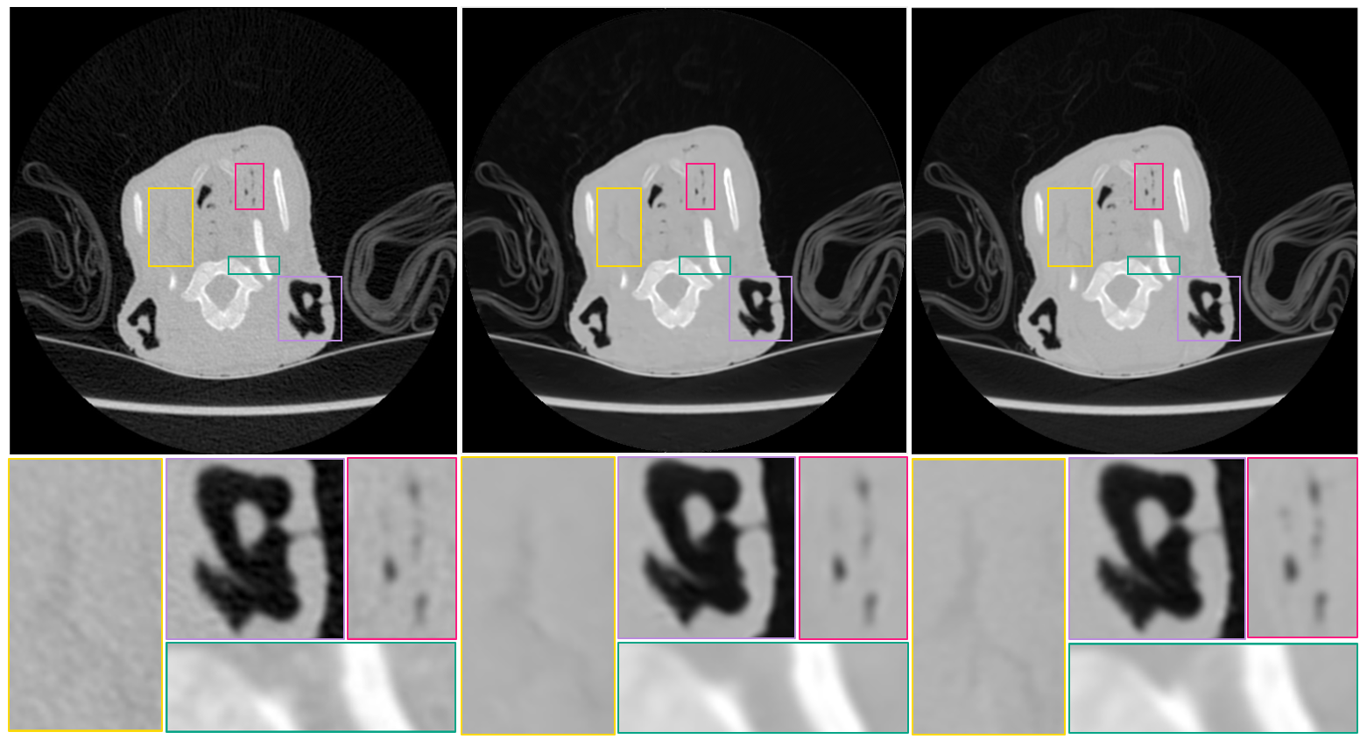
Results – SSIM+edge
Noisy image
Result image
Clean image

Slide 24
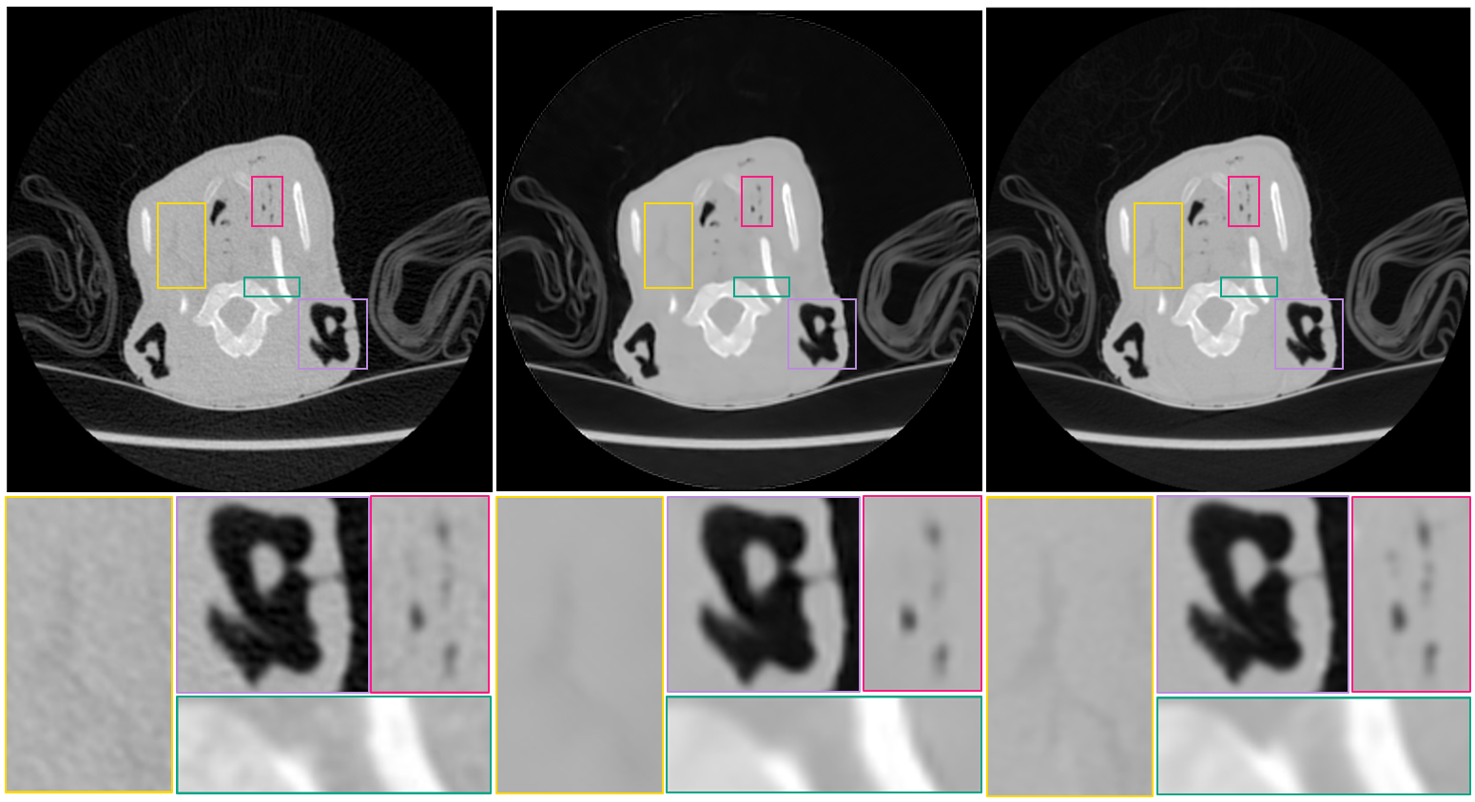
Results – SSIM+edge (wavelet)
Noisy image
Result image
Clean image

Slide 25
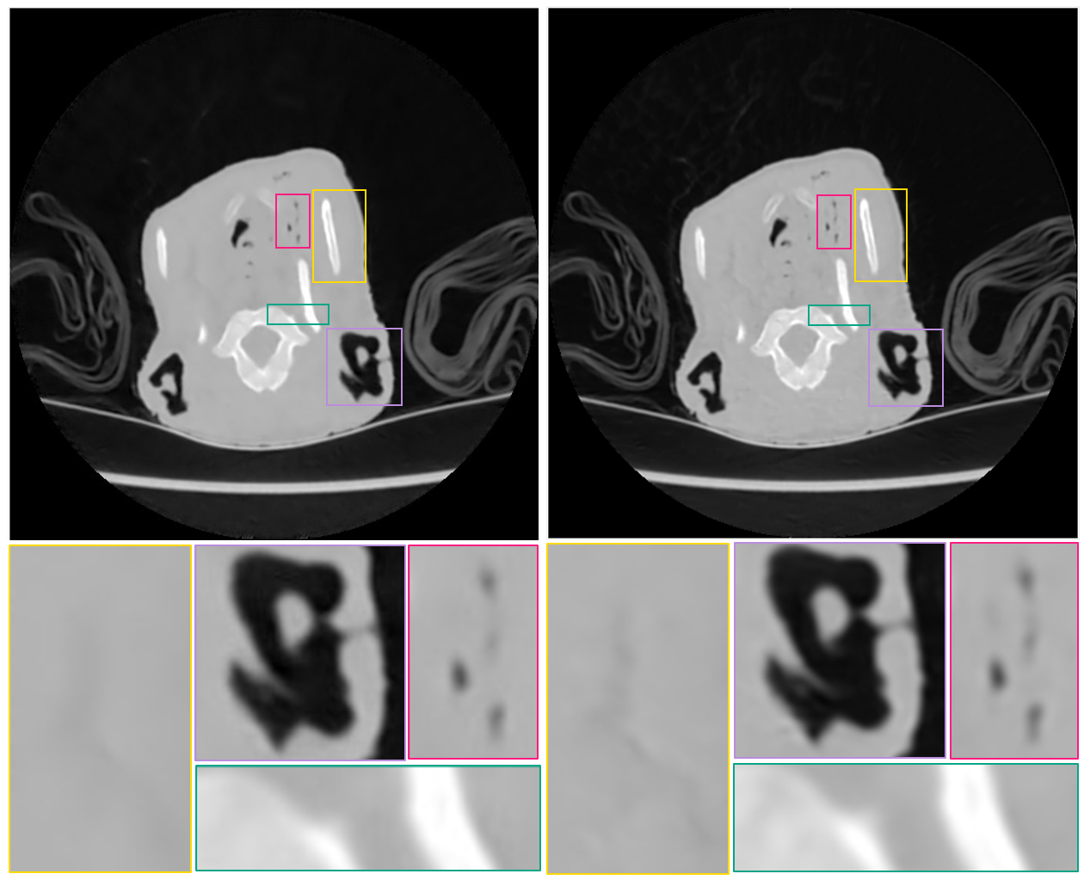
MSE+edge vs. SSIM+edge
MSE+edge result
SSIM+edge result

Slide 26
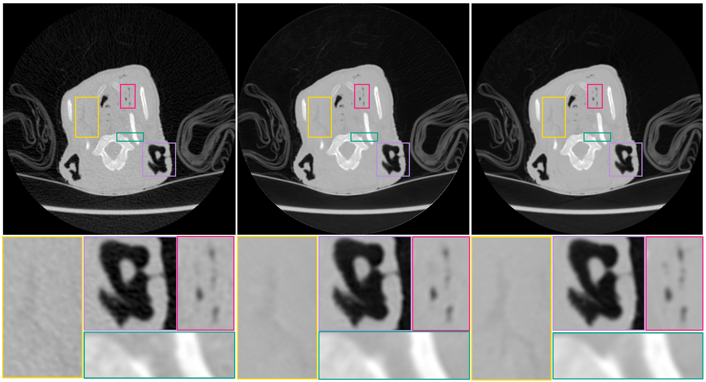
Results – Perceptual+edge
Noisy image
Result image
Clean image

Slide 27
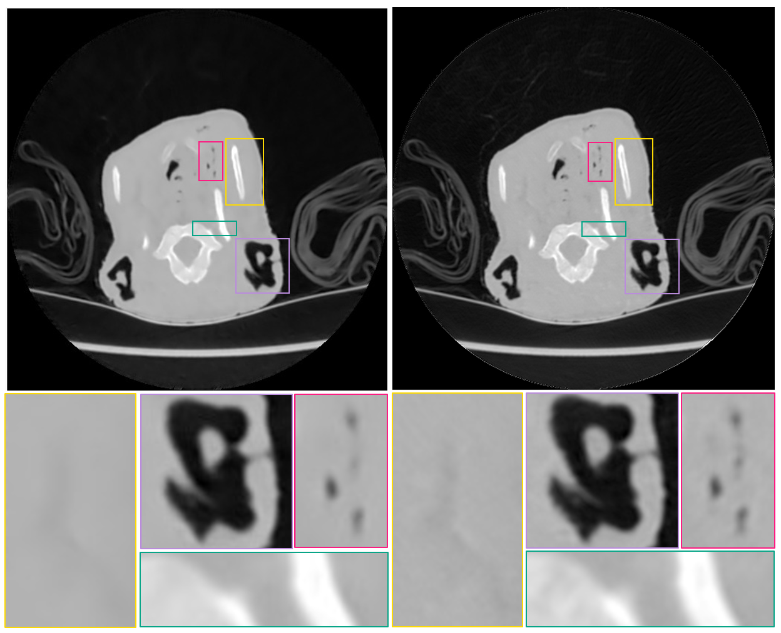
MSE+edge vs. Perceptual+edge
MSE+edge result
Perceptual+edge result

Slide 28
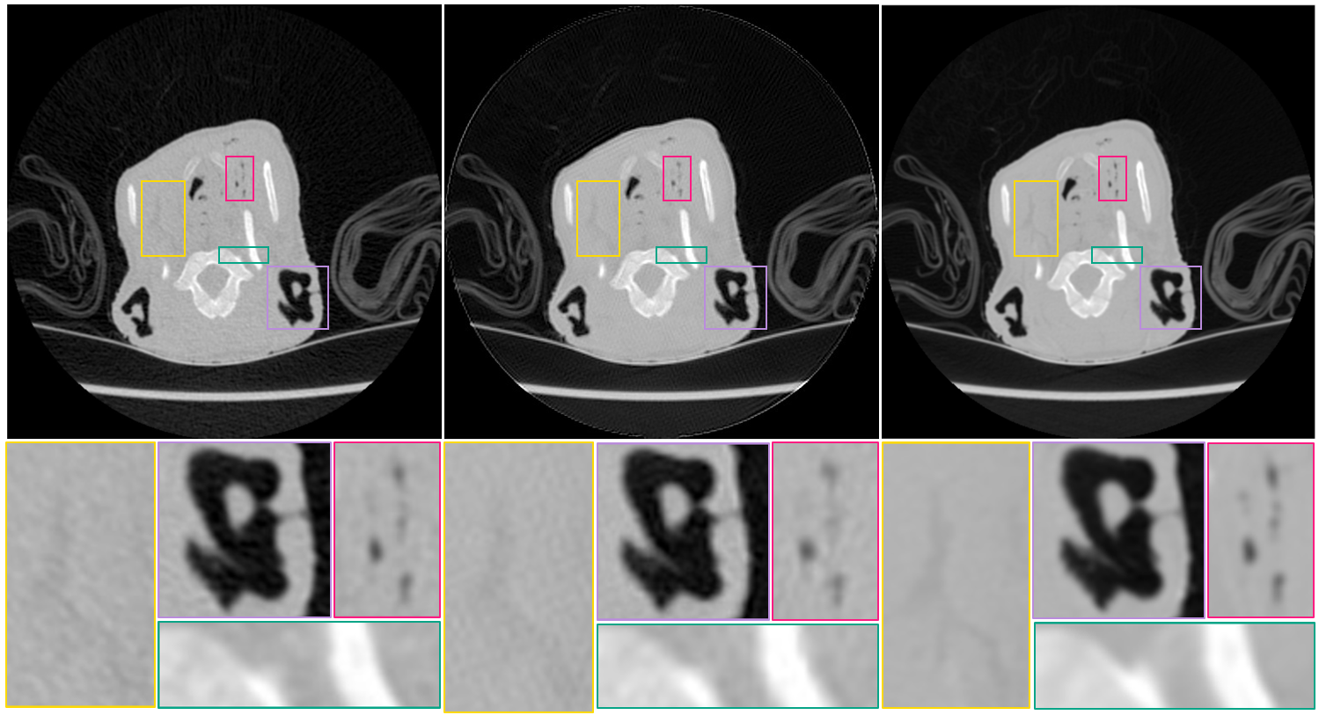
Results – Perceptual+edge (wavelet)
Noisy image
Result image
Clean image

Slide 29
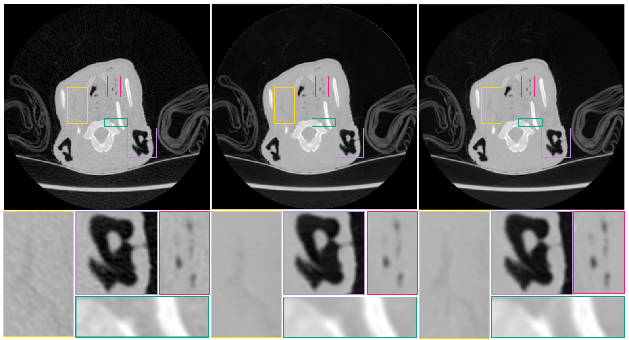
Results – Perceptual(70%) + MSE(30%) + edge
Noisy image
Result image
Clean image

Slide 30
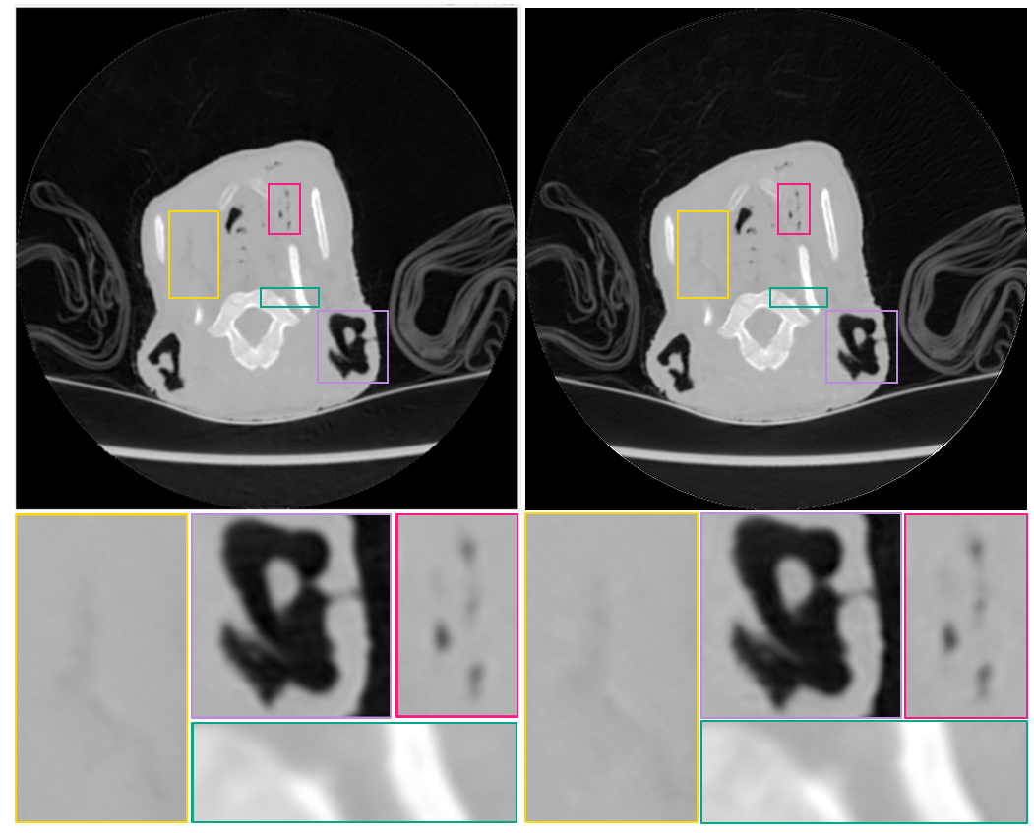
Perceptual vs. Perceptual+MSE
Perceptual+MSE+edge result
Perceptual+edge result

Slide 31
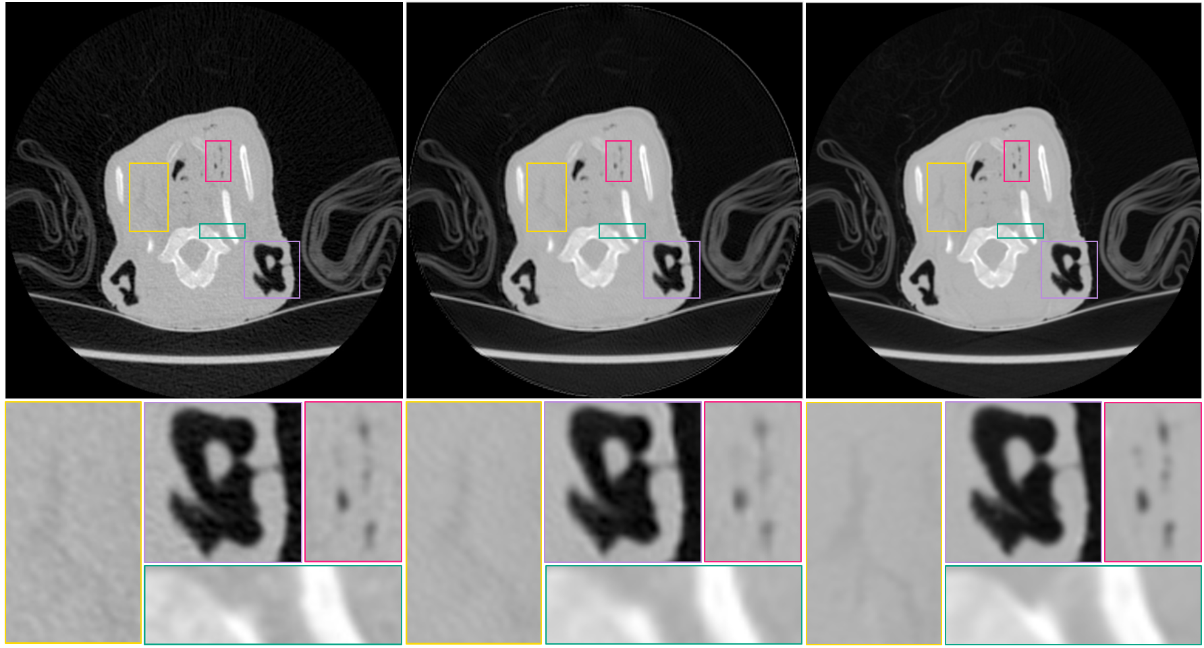
Results (wavelet) – Perceptual(70%) + MSE(30%) + edge
Noisy image
Result image
Clean image

Slide 32
PSNR & SSIM comparison
 | Original Images |  | MSE |  | MSE & Edge
 | Image | Wavelet | Image | Wavelet | Image | Wavelet
PSNR | 39.6711 | 34.2185 | 42.8937 | 34.9906 | 44.6431 | 34.9989
SSIM | 0.9594 | 0.9515 | 0.9555 | 0.9737 | 0.9892 | 0.9719
 | Perceptual & Edge |  | Perceptual & MSE & Edge |  | SSIM & Edge
 | Image | Wavelet | Image | Wavelet | Image | Wavelet
PSNR | 37.2077 | 33.2119 | 37.0332 | 33.7946 | 42.6907 | 34.9906
SSIM | 0.9791 | 0.9527 | 0.9769 | 0.9594 | 0.9873 | 0.9737

Slide 33
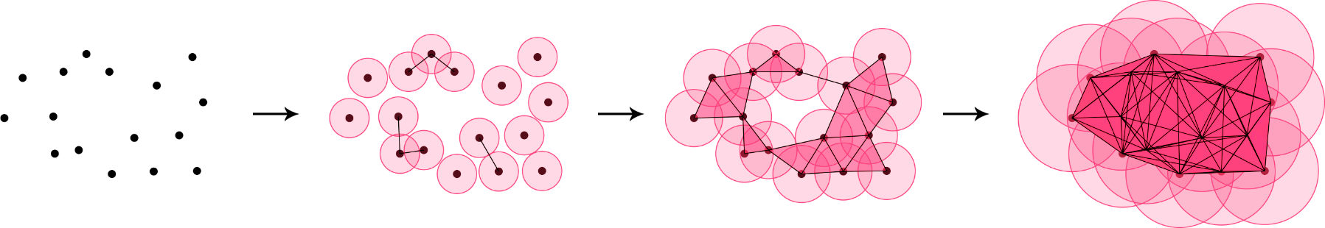
Persistent homology
A topological tool.
Frequently used to investigate the characteristics of manifolds (for example: number of connected components, cycles, ex.).
Can be used in order to compare complexity of two manifolds.

Slide 34
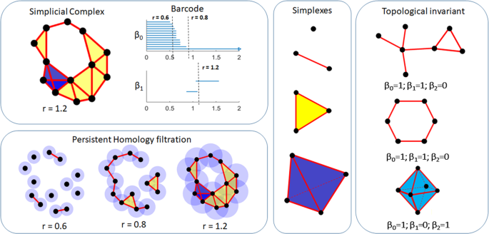
Persistent homology

Slide 35
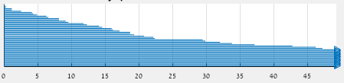
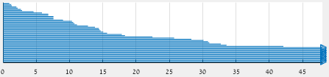
Persistent homology analysis
Barcodes for original image (up) and wavelet transform (down)

Slide 36
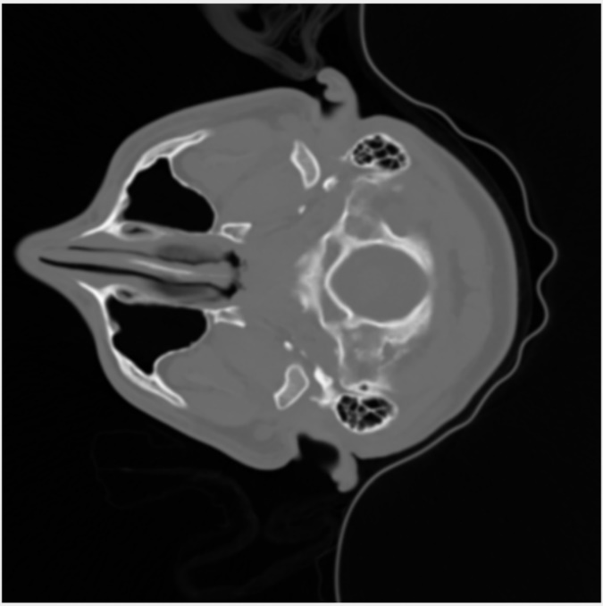
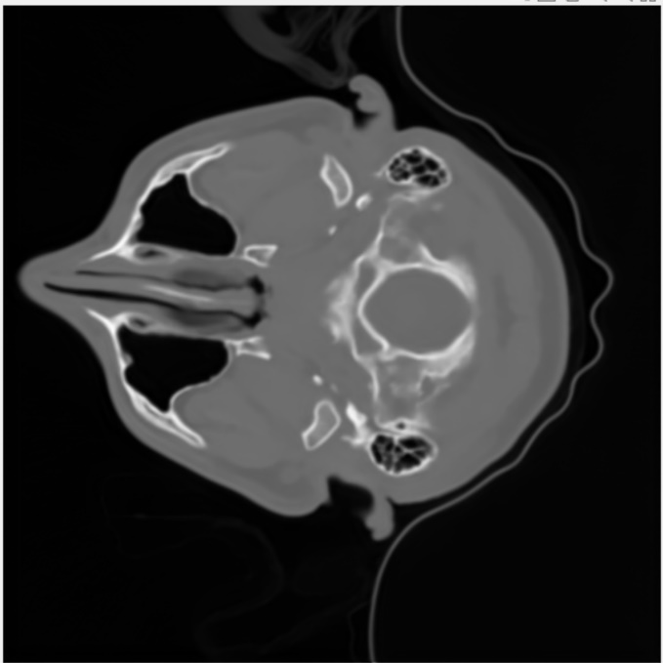
Denoising clean CT scans
Original image – gradient’s average 0.0861
Result image –
gradient’s average 0.0836

Slide 37
Summary
In this project, we proposed a residual learning based neural network for denoising low-dose CT scans.
an edge-detection layer was implemented.
different loss functions were examined.
Finally, we tested the possibility of using the images’ wavelet transform as input, in order to make the learning more efficient.

Slide 38
Conclusions
The proposed network achieved the best results when using the combined Perceptual and MSE loss function.
The edge detection layer sharpened the edges and made the results less blurry and more accurate.
The wavelet transform as input achieved satisfying results, although blurrier, and training time was two times shorter.
Future work:
With wavelet transform as input, the net didn’t train well for the combined loss function – try to overcome the convergence to local minima.

Slide 39
References
W. Bae, J. Yoo and J. C. Ye, "Beyond Deep Residual Learning for Image Restoration: Persistent Homology-Guided Manifold Simplification," 2017 IEEE Conference on Computer Vision and Pattern Recognition Workshops (CVPRW), Honolulu, HI, 2017.
M. Gholizadeh-Ansari, J. Alirezaie and P. Babyn, "Low-dose CT Denoising Using Edge Detection Layer and Perceptual Loss," 2019 41st Annual International Conference of the IEEE Engineering in Medicine and Biology Society (EMBC), Berlin, Germany, 2019.
H. Zhao, O. Gallo, I. Frosio and J. Kautz, "Loss Functions for Image Restoration With Neural Networks," in IEEE Transactions on Computational Imaging, vol. 3, no. 1 , pp. 47-57, March 2017.

